Slide 1
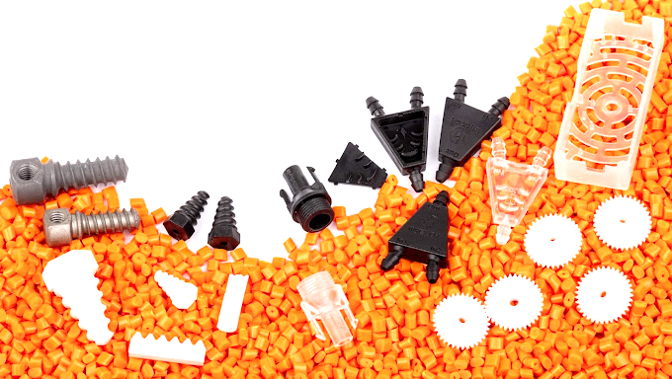

Intro to
Thermoplastics
And other bedtime stories

Slide 2

Warning:
The contents of this presentation are highly subjective.
Consult manufacturers’ data sheet for professional recommendations.

Slide 3
Why plastics?
Generally poor performance
Workability
Recyclability (mostly)
Incredibly widespread usage

Slide 4
Not really a plastics guy…
Originally worked in metal-working and fibre-reinforced composites (automotive/aerospace)
Came to Zürich to develop injection moulding machines
Startup in Öerlikon, from 4 people to ~40 people in two years

Slide 5
What we do at Torson Injex AG
Experience with over 400 thermoplastic resins, elastomers and blends
Complex geometries, limited quantities, crazy materials
https://www.injex.ch/en
https://www.instagram.com/torsoninjexag/

Slide 6
Making plastic into different shapes:
Medical / Pharmaceuticals / Surgical
Aerospace / Automotive / Electronics
Jewellery / Consumer / Wearables
Laboratory / Chemistry / Cryogenics

Slide 7
A brief history of plastics
really
^
πλάσσω - plássō, “to mould, form”
Synthetic plastics - 1869
Usefulness: deformable, but durable
Pacific garbage patch
Need smarter use and selection of plastics

Slide 8
“Other bedtime stories”...
Silicone
Elastomers
Impregnation
Blends
Specialty binder

Slide 9
You can go home now if you thought this was about:
Foams
Thermosets
ASA
Concrete/cement

Slide 10
Ways of processing
Injection moulding
Extrusion
Thermoforming
3D Printing
Laser Cutting/CNC Machining
Highest popularity
Cost/time per tool
More material options
Most familiar
Cost/time per part
Limited materials

Slide 11
Material Performance
Selection
Manufacturability:
Processing temp (range)
Hygroscopy (moisture)
Shrinkage
Operating:
Operating temp
Strength
Stiffness (not the same)
Chemical inertness
Fire retardancy
UV stability
Biocompatibility

Slide 12
There are too many different types…
General purpose:
PP
HDPE/LDPE
PLA
ABS
PBT
PET (Polyester, PET/PETG)
PS/HIPS
High(er) performance:
PEEK
LCP
PA
PC
PEI
PSU
Specialty:
MIM
CIM
Elastomers
Self Lubricating Plastic
Gold powder
Aramid
PTFE
POM

Slide 13
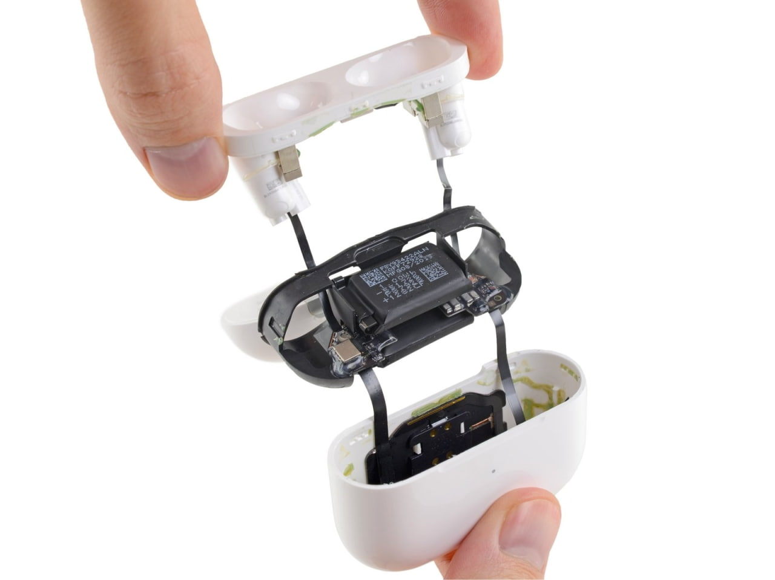
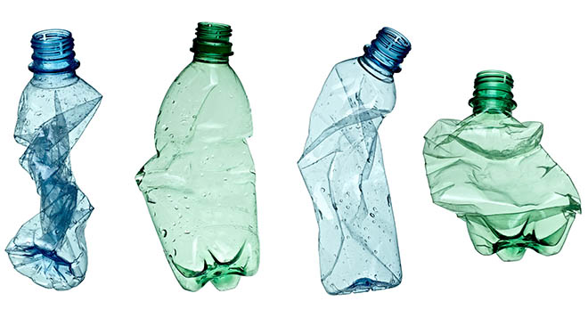
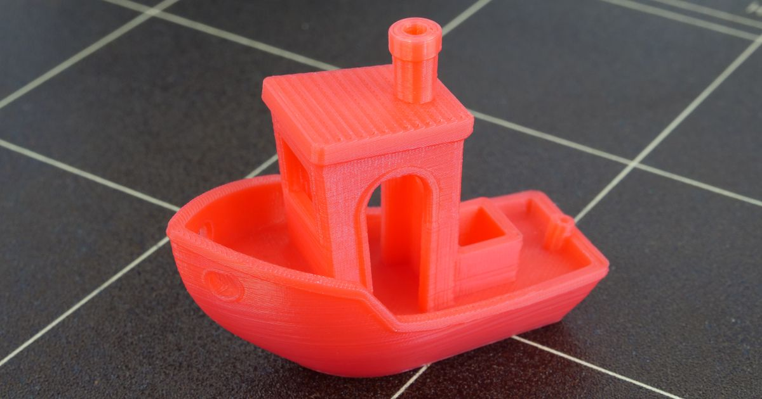
The easy ones:
PLA
ABS
PETG
(3D Printable)
Easy to print with
Low shrinkage <1%
Brittle but stiff
Not used in a primary industry outside of 3D Printing
Higher operating temperature
Non-recyclable
High impact resistance
High shrinkage ~2%
a.k.a PET (feat. Glycol) or Polyester when used as fibre
Middle ground of ABS and PLA
Good adhesion
As seen in: drink bottles, synthetic clothing
180-240*C (60*C)
230-260*C (60-100*C)
230-260*C (60-80*C)

Slide 14
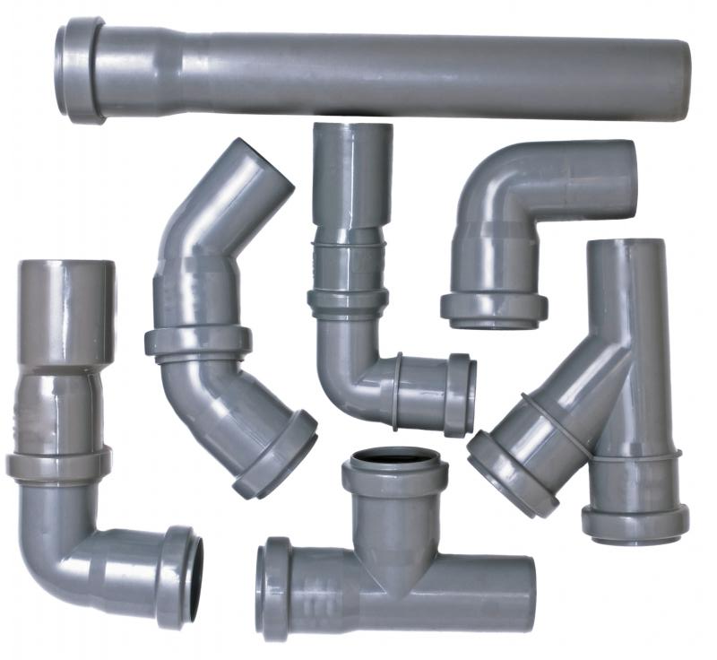
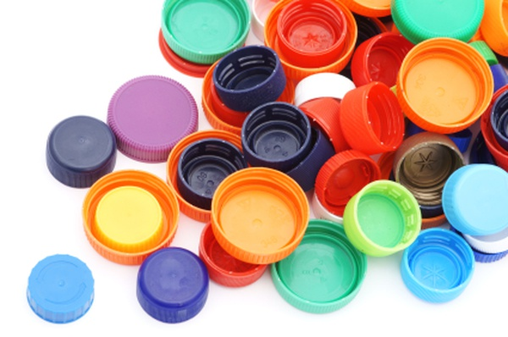
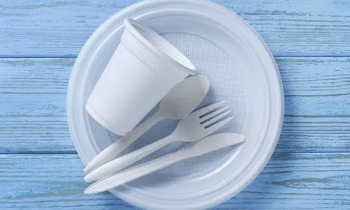
The common ones:
PS (Polystyrol/Polystyrene)
HDPE/LDPE
PVC
(Low temperature but not 3D Printable)
Blow moulding, thermoforming
Low density
Generally not recycled
High/Low Density Polyethylene
Compression moulding
Laundry bottles and lids, cable glands
Flexible, cheap
Fairly toxic when heated
Extrusion, blow moulding
Durable and flexible
Plumbing pipes

Slide 15
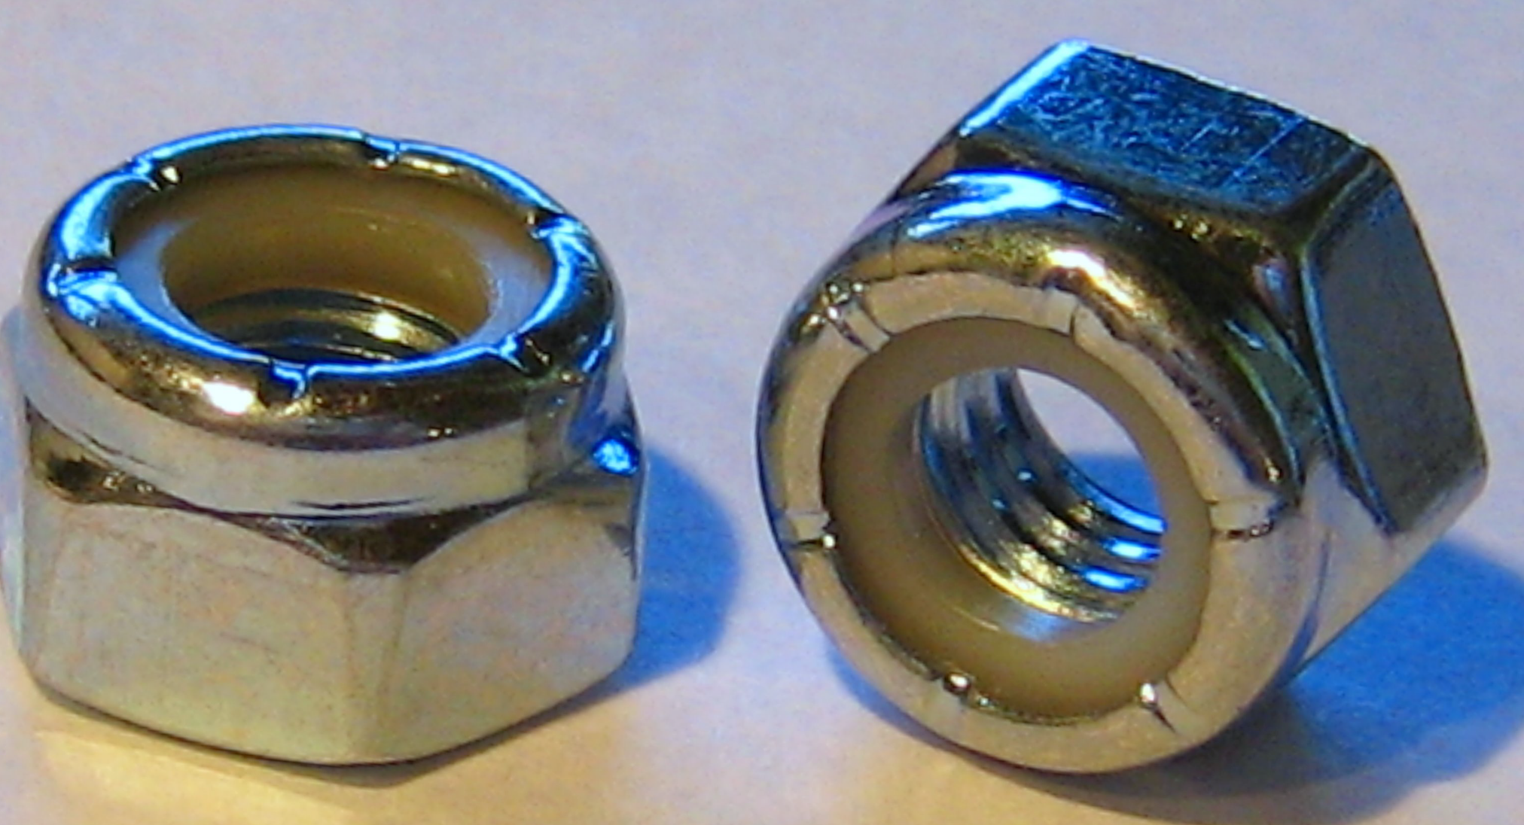
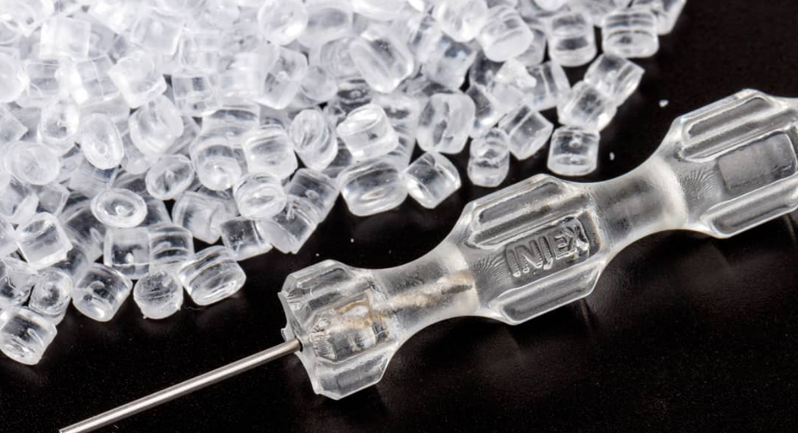
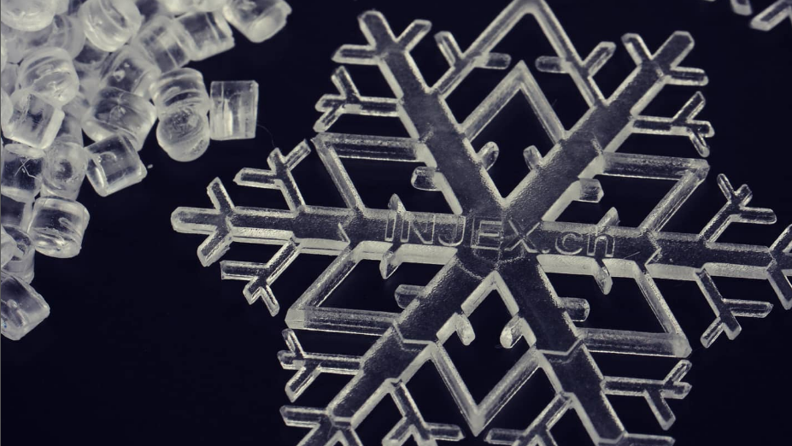
The fan favourites:
PA (Polyamide)
PC (Polycarbonate)
PP (Polypropylene)
(3D Printable performance)
a.k.a Nylon, also used as a fibre
Absorbs moisture like craaazy 😤
Very high shrinkage >2%
High impact resistance
Flexible
Many blends e.g. PA12, PA66
Very high impact resistance (used for blast screens, riot shields, etc.)
Flame retardant (different grades)
Very difficult to process
Very high shrinkage
Wide processing temperature
Low viscosity
Low stiffness (flexible)
Very little internal stress (effectively low shrinkage)
Works wet and dry 👍
Easy to clean
Inert/biocompatible
250-320*C (80-120*C)
280-320*C (100-120*C)
180-320*C (0-60*C)

Slide 16
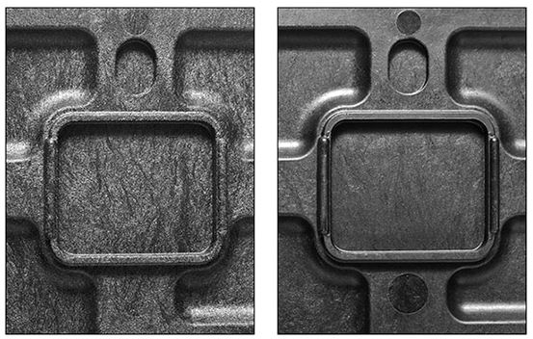
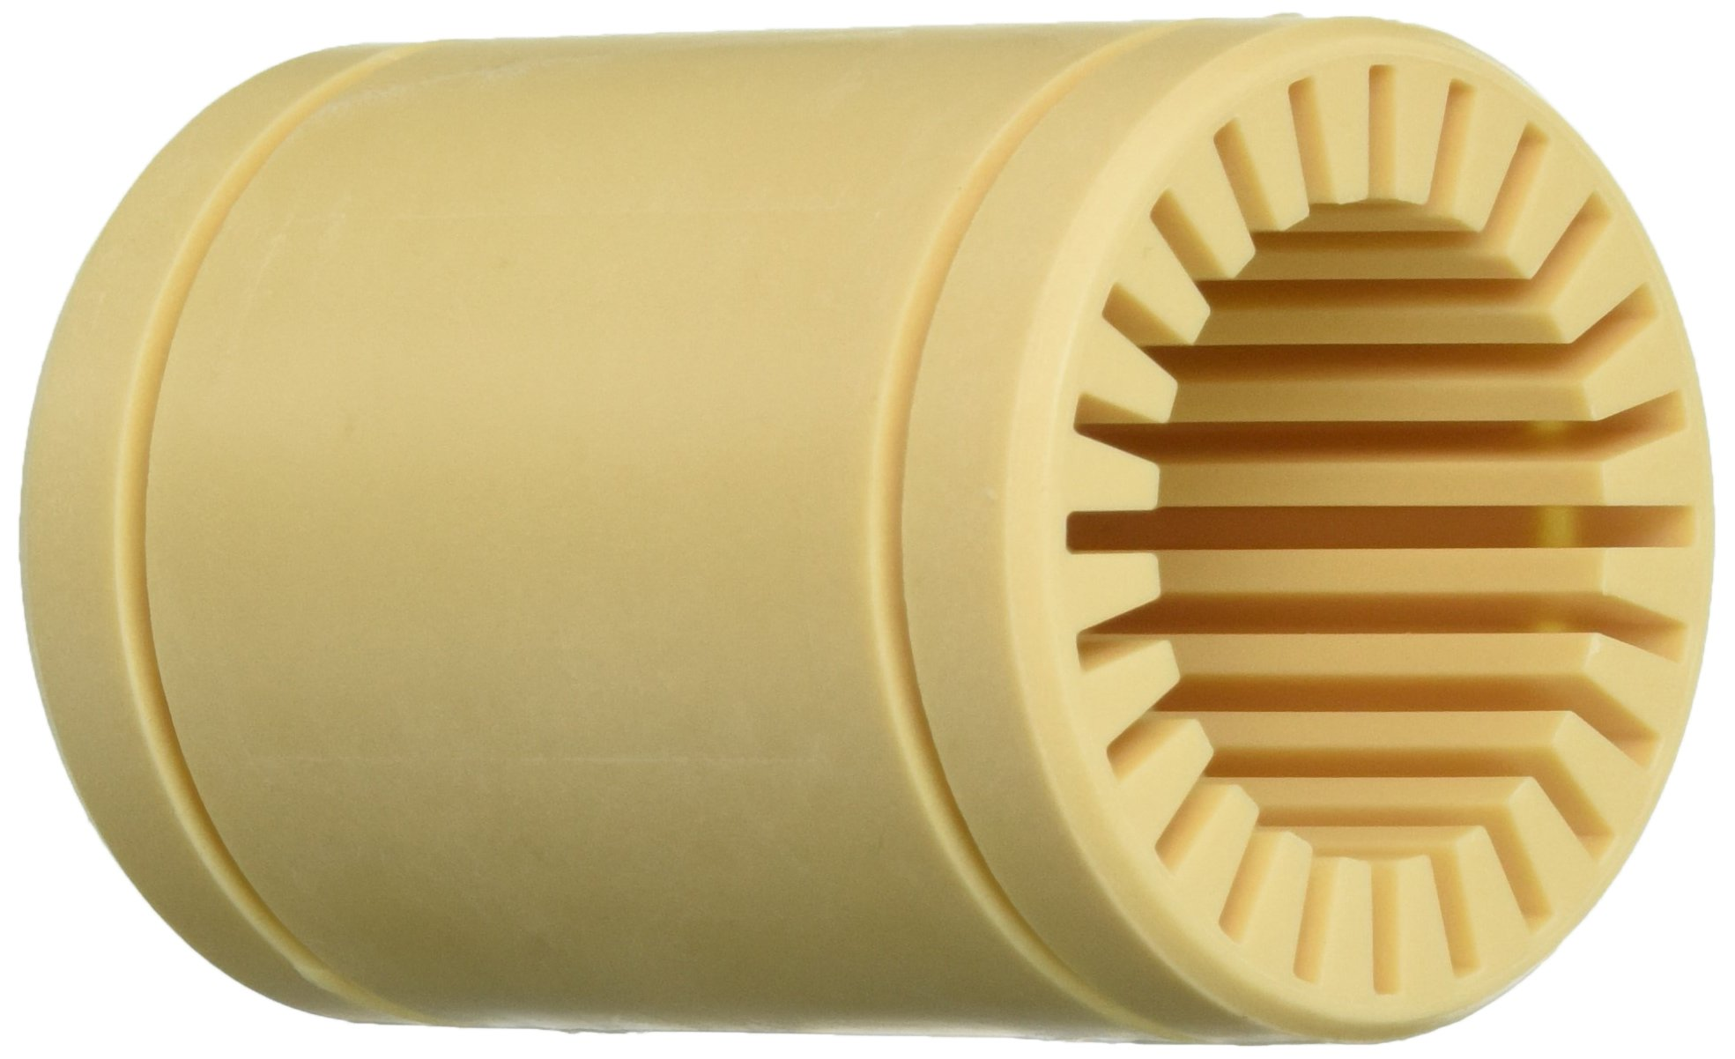
The impregnated ones:
Glass Fibre
Carbon Fibre
Self lubricating
(Also 3D Printable)
Usually 10/15/25/40/50%
Adds rigidity and stability against shrinkage at the expense of elasticity/fatigue resistance
Little difference to process temperatures but very abrasive
Can be added to anything without changing colour
Often paired with PA, PBT, PSU, PP
Same as Glass but stronger and lighter (marginally)
Turns your material black
More abrasive (I think)
Can get clogged in small orifices
Goes well with PETG, LCP, PEEK
“IGUS Tribo Filament”
Self lubricating polymer for low friction and temperature stable bearing surfaces
Much more expensive than rolling element bearings
220-240*C (60-80*C)

Slide 17
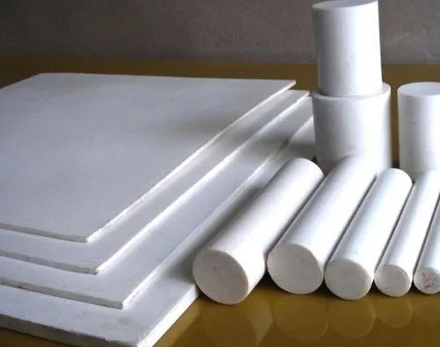
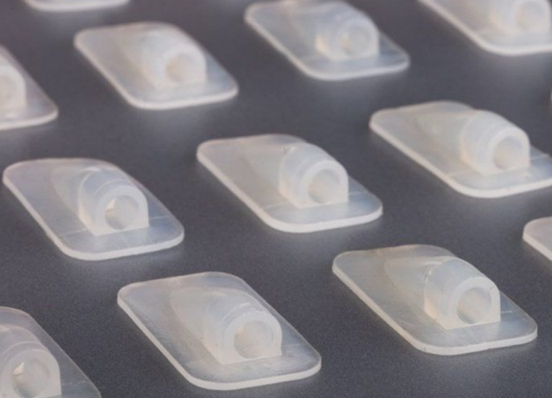
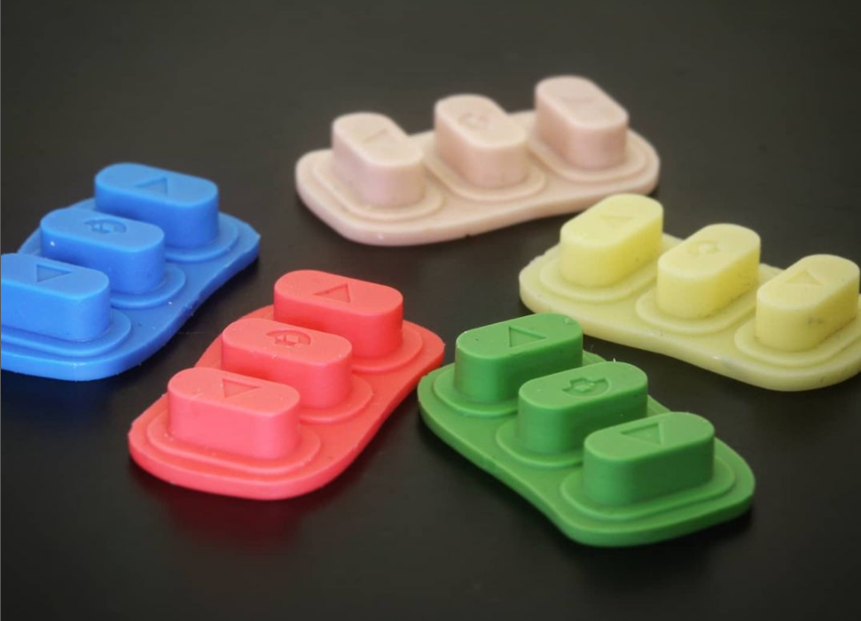
The overachievers:
PTFE
TPU (Thermoplastic Polyurethane)
Silicone
Just amazing in every way except workability Really low friction
Doesn’t really melt (can be a good or a bad thing 🤷‍♂️) Operating temp 260*C
3D Printable
Extremely durable
Flexible and easy processing parameters
Vibration damping
High inertness
High temperature resistance
Flexural modulus 💪
180-220*C (0-60*C)

Slide 18
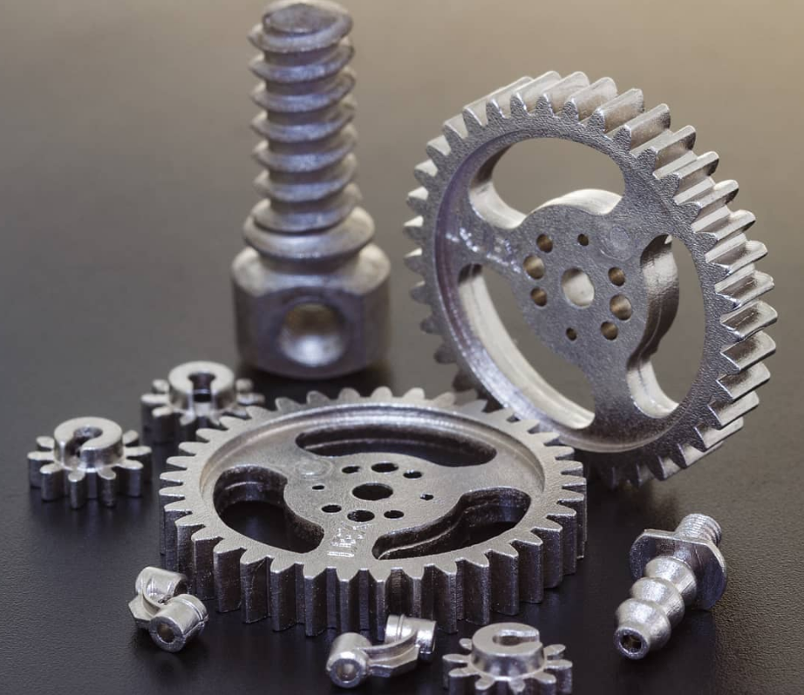
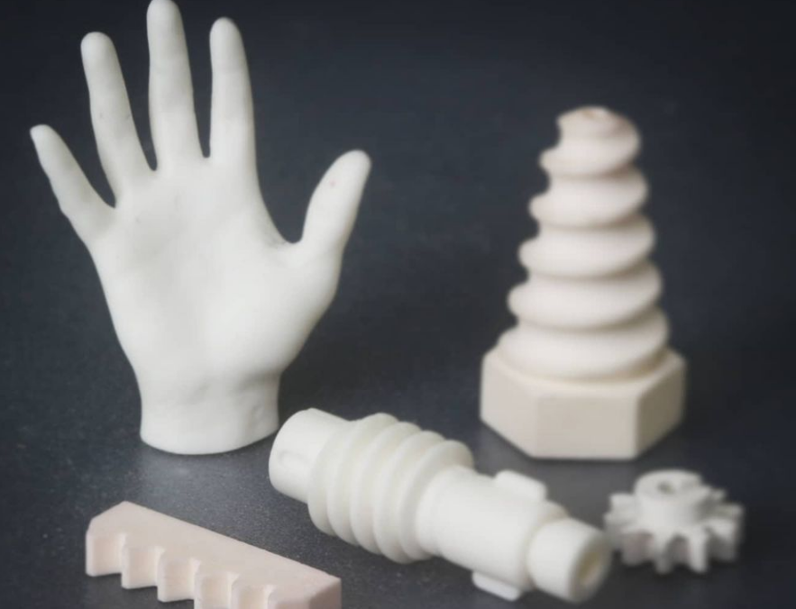
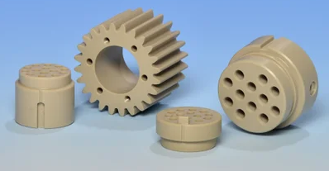
The ones they don’t teach you about:
PEEK
MIM (Metal Injection Moulding)
CIM (Ceramic Injection Moulding)
Ultra high (360-400*C) processing temperature
Operating temperature approx. -40 - 250*C
Ridiculous durability
Extremely expensive
Machinable
Surgical Stainless Steel
Inox Stainless
Moulded as a green part and then sintered
Sintered as high temperature Alumina Ceramic
Really complex geometries possible
Ultra high hardness (unachievable by machining)

Slide 19
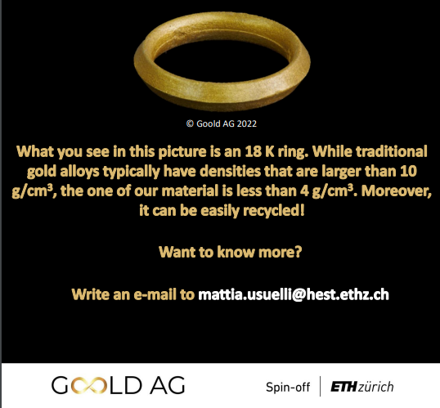
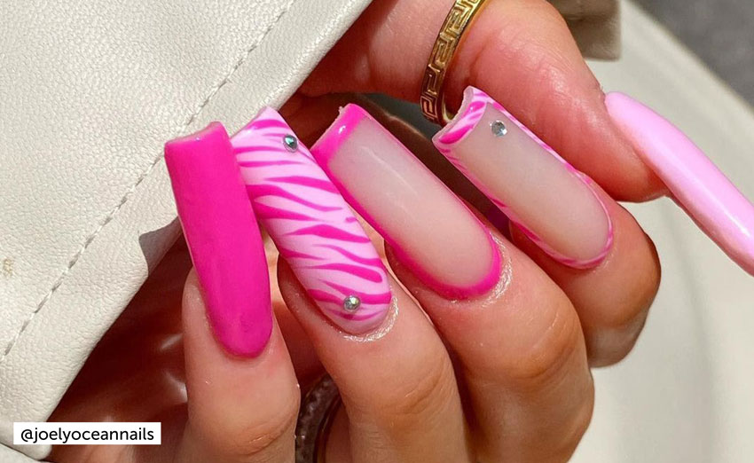
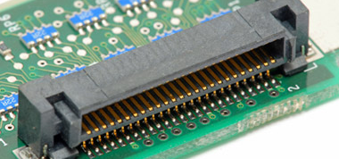
Can’t think of a name for these:
PMMA
LCP (Liquid Crystal Polymer)
GOLD
a.k.a Plexiglass, Acrylic
Laser cutting, thermoforming
Very brittle
Poor chemical resistance
Outgasses
Not yet 3D Printable (doesn’t stick to itself)
Incredibly durable with long polymer chains
Electronics components (resistant to soldering temperatures)
Can be stabilised with glass or carbon fibre
Just announced by ETH Spin-off
I personally worked on this

Slide 20
Ones I didn’t mention but are worth looking into:
PBT
PS/HIPS
PEI
PSU
Aramid
POM/Acetal

Slide 21
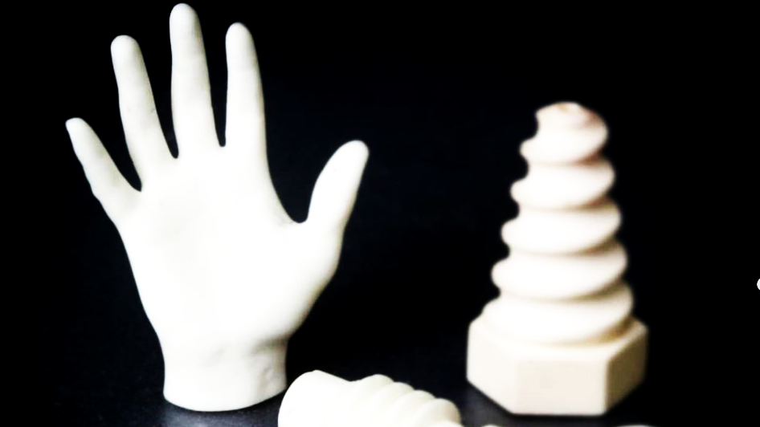
Questions! 🙋‍♀️
And also what’s your favourite material?

